Slide 2
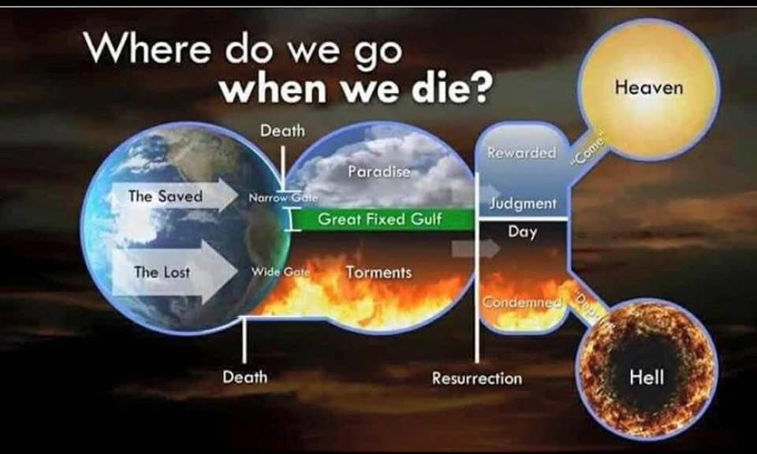

Slide 3
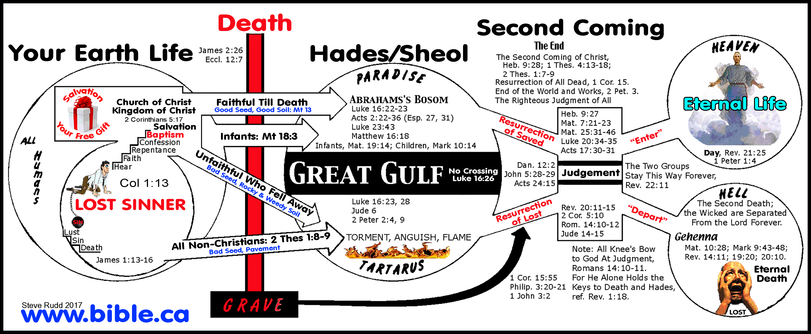

Slide 4
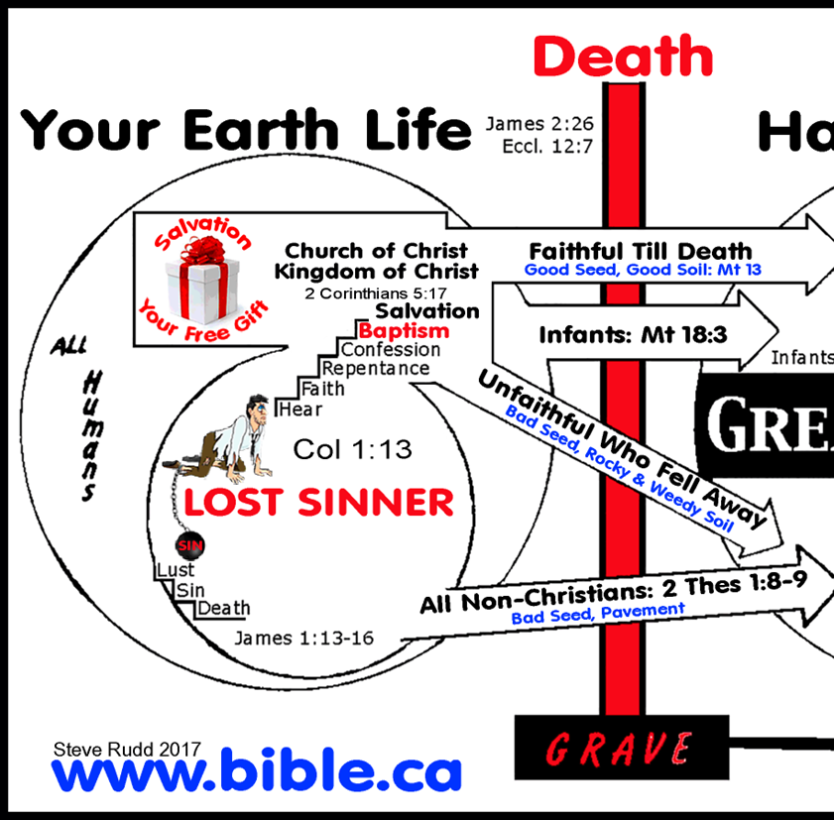
Birth – Matthew 19:14
What does it mean to OBEY THE GOSPEL OF JESUS CHRIST?
Mark 16:15,16
Acts 17:30,31
Romans 10:10
Acts 2:41
Revelation 2:10
Acts 2:47
Colossians 1:13
Unfaithful – Hebrews 10:26
1 John 1:8-10
Galatians 5:4

Slide 6
James 2:26 “body without the spirit is dead”
Ecclesiastes 12:7 “Then the dust will return to the earth as it was, And the spirit will return to God who gave it.”
Hebrews 9:27 “And as it is appointed for men to die once”
ALL must DIE and THEN THE JUDGMENT!
Where are the dead between DEATH and the JUDGEMENT?

Slide 8
Luke 16:19-31
Hades - “is from ἅ́δης hadēs, signifying all–receiving. It corresponds to “Sheol” in the O.T.” “..the nether world, the realm of the dead.”
Tartarus- “ “...the lower part, or abyss of Hades,...where the shades of the wicked were supposed to be imprisoned and tormented.”
Revelation 20:10 “...into the lake of fire and brimstone where the beast and the false prophet are. And they will be tormented day and night forever and ever.”
Jude 6

Slide 9
Luke 16:19-31
Abraham’s Bosom- place of comfort and honor
Paradise – Luke 23:43
How do we KNOW? Acts 2:27
“beautiful garden, generally the property of someone of royalty or great wealth.”
No way for anyone to cross over from one part to the other!
The way we are SPIRITUALLY whenever we die, will determine WHERE WE WILL BE IN HADES!

Slide 11
Universal Resurrection Of The Dead – John 5:28,29
Not ALL will come forth for the SAME REASONS!
Revelation 20:11-15 “dead were judged according to their works, by the things which were written in the books”
What about the way we should conduct our lives?
2 Peter 3:9-12
Is YOUR life characterized by HOLY CONDUCT and GODLINESS?
S

Slide 12
Are You Prepared To Face The Inevitable?
Death Is In Our Future!

Slide 13
Why Not Begin Making Preparation NOW!
If You Have Veered From The Path, Return!

